Slide 1
Automation testing-1
Balkrishna sir

Slide 2
Java history
James Gosling is known as Father of Java. He initiated the Java language project in June 1991. The team was called as Green Team. Initially it was called Oak which is name of the tree.
In 1995 Gosling joined Sun Microsystems and there he and his team started work on new project of java language and release first version of Java JDK 1.0 on 23 Jan 1996.
In 1995, Oak was renamed as Java. Java is an Island of Indonesia where the first was produced. Java name was chosen by James Gosling while having coffee.
Latest version of Java is Java SE 14 released on 17 March 2020.

Slide 3
Java introduction
Latest version of Java is Java SE -14 released on March 17, 2020.
Java Advantages:
Platform Independent: Java programs can move from one system to another system anytime. That is it can run on any platform.
Simple: Java is a simple programming language. Java is user-friendly. It is small and simple language.
Object-Oriented: Java is Object-Oriented programming language. The whole program code arranged in the form of object and classes.
Multithreaded: Java handles multithreaded programs means it handles multiple tasks simultaneously. No need to wait to finish one task before beginning another.
Secure: Java language is more secure. Java system does not allow access to anything without proper authorization.
Robust: Java is a robust language. It functions like garbage collector which manage memory problems. It works as exception handling language that is it captures the error and avoid problems to the system.

Slide 4
Java introduction
Where java is used:
Desktop Application
Web Application
Big Data
Mobile Based Applications
Embedded System
Robotics
Classification of java programming language:
J2SE: Java to Standard Edition- It is java programming platform which is mainly used to develop standalone applications.
J2ME: Java 2 Micro Edition- It is a micro platform which is mainly used to develop mobile applications.
J2EE: Java 2 Enterprise Edition- It is enterprise platform which is mainly used to develop web and enterprise edition.

Slide 5
Java introduction
Types of Applications:
Standalone Applications: Standalone Applications are also known as Desktop applications. These are applications that we need to install on every machine. Example- Notepad.
Web Applications: An applications that runs on server side and creates dynamic pages. Example- Facebook.
Enterprise Applications: An applications that is distributed in nature, such as banking applications. Example- Banking Applications.
Mobile Applications: An applications which is created for mobile device.

Slide 6
Java introduction
What is Java?
Java is computer programming language.
Java does not use for single purpose it used for multi purpose.
Java promises WORA- Write Once Run Anywhere.
Java programming language used in s/w as well as h/w.
Java is OOPs language.
In s/w it is used to design and develop the s/w and in h/w it is used to run s/w.

Slide 7
Java installation
To Uninstall Software:
1. Go to Control Panel
2. Programs
3. Uninstall software you want.
To check java installed or not:
1. Go to ‘C’ drive.
2. Program files.
3. Java file check.

Slide 8
Java installation
To install JDK software:
Open Google Chrome.
Type Java JDK download.
Java SE: Oracle Technology Network.
JDK Download.
Jdk-14.0.2_windows.X64_bin.exe.
Copy Java folder to another folder.
Run as Administrator.
Window Pop Up click ‘Yes’ button.
Next and Close.

Slide 9
Java installation
To add JRE files:
Click on ‘Start’.
Go to ‘Settings’ option.
Search for Environment Variable option- Select ‘Edit the system environment variables’.
In ‘Advanced’ option go to the ‘Environment Variables’.
In ‘System Variables’ go to the ‘path’ variable double click on that.
Go to the ‘C’ folder where we installed the JDK.
Go to ‘Program files’.
Go to the ‘Java’ folder.
Go to the ‘JDK-14.0.2’ folder.
Go to the ‘bin’ folder.
Copy that path upto bin folder and paste it to ‘Edit Environment Variable’ place.

Slide 10
Java installation
To add JAVA_HOME to system variable:
Click on ‘New’ option in system variable.
Enter variable name- JAVA_HOME and variable value- path upto jdk-14.0.2 from ‘C’ folder.
Click on ‘OK’.
Click on ‘OK’ on environment variable window.
Click on ‘OK’ on System Properties window.
Download Eclipse:
Open Google Chrome.
Type Eclipse Download.
Eclipse Download/ The Eclipse Foundation.
Download 64-bit.
Download.

Slide 11
Java installation
Eclipse Installation:
Copy eclipse file to another folder.
Right click and run as administrator.
Window Pop-Up click on ‘Yes’ button.
Eclipse IDE for Java Developers.
Install.
Accept Now- License Terms and conditions.
Unsigned content – Tick mark Remember choice and accept.
Launch.
After launching process it will ask for workspace that is where you want to save the programs.
Select directory as workspace click on browse option.
Select path where you created new folder.
Launch and welcome window opens.

Slide 12
Java installation
To create new project:
Go to ‘File’ option.
New.
Java Project.
Enter details and Finish.
To create new package:
Right click on ‘src’.
New.
Package.
Enter details and Finish.
To create new class:
Right click on created program.
New.
Class and Enter details and Finish.

Slide 13
Java class
What does your project contain?
JRE System Library: JRE is a Java Runtime Environment. It is set of tools used to develop Java Applications. It is used to provide the runtime environment. It is the implementation of JVM. It contains set of libraries + other files that JVM uses at runtime.
Src: Source is nothing but interaction between end user and tool that perform specific role. Src contains packages and classes.
Test Data: Test data is user defined. It used to store the data which can be used during testing of application.

Slide 14
Java class
Class: Class is collection of Member functions(Methods), Printing statements, Scanning statements, objects, Loop statements, Constructors, Variables, Data types, Control statements.
Semicolon: To stop or finish the statement we use semicolon.
Public: Decides the scope of the class whatever we decides public we can use in whole project.
{ }: This is nothing but class body. Whatever methods, objects, etc we declare it should be inside the curly braces.
(“ “): Whatever message you want to print it should be in round bracket and double inverted commas.
Package: Package is nothing but collection of multiple classes in it. If you do not create package in program, it will create default package.

Slide 15
Java class
Package: Package is nothing but collection of multiple classes in it. If you do not create package in program, it will create default package.
Advantages of package:
- Used to categorise the classes and interfaces so that they can be easily maintained.
- Provides access protection.
User defined packages:
1. Using packagename.*
If you use package.* then all classes and interfaces of another package accessible but not sub packages.
2. Using packagename.classname
If you import packagename.classname then only declared class of this package will be accessible.
3. Using fully qualified name
- If you used this then only declared class of this package will be accessible no need to import. It generally used when 2 package have same class name.

Slide 16
Program
Class Simple {
public static void main(String[] args) {
System.out.println(“Hello Java”);
}
}
Program Explanation:
Class: Used to declare the class.
Public: Define scope of class.
Static: Static method is that there is no need to create object to invoke static method. Main method executed by JVM. It saves memory.
Void: It is return type of method. It means it doesn’t return any value.

Slide 17
program
Main: Represent starting point of program.
String[] args: It is used for command line arguments in the form of string value.
At Runtime:
Class Loader: It is used to load class files.
Bytecode Verifier: Checks the code fragments for illegal code.
Interpreter: Read bytecode stream then execute instructions.
Compiler converts source code to bytecode.

Slide 18
Java methods and types
Methods: A method is block of code or collection of statements grouped together to perform certain operations. It is used to achieve reusability of code. We write method once and use it many times.
There are 2 types of methods:
1. Business Method or Main method:
Syntax-
public static void main(String[] args){ }
- Without main method we cant execute any function in program.
2. Regular Method:
There are 2 types of Regular Methods
a. Static Method
b. Non-Static Method

Slide 19
Java methods and types
Static Method:
Syntax-
public static void addition() { }
Non-Static Method:
Syntax-
public void addition() { }
Method Declaration:
Method Signature: Every method has method signature. It includes method name and parameter list.
Access Specifier: Specify visibility of method.
Return Type (void): It is return type of method. It means it doesn’t return any value.
Method Name: It is unique name used to define name of method.
Method Body: It contains all the actions to be performed.
Parameter List: It is the list of parameter separated by comma. It contains data type and variable name.

Slide 20
Java methods and types
Note:
At the time of program execution main() method is going to executed automatically first whereas regular method are not going to be executed automatically.
At the time of program execution priority is scheduled for main() method only.
To execute regular method programmer need to make call from main method until and unless if the call is not made then regular method will not get executed.
Regular methods can be declared and called multiple times in program.
Methods:
Methods are declared inside class body.
Methods are used to perform code reusability operations.
Inside class body programmer can declare any number of methods.

Slide 21
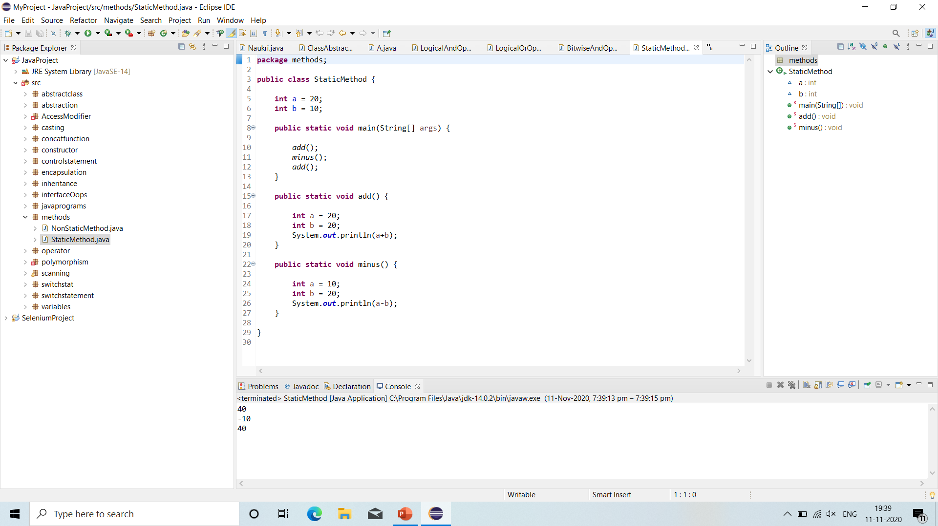
Static method

Slide 22
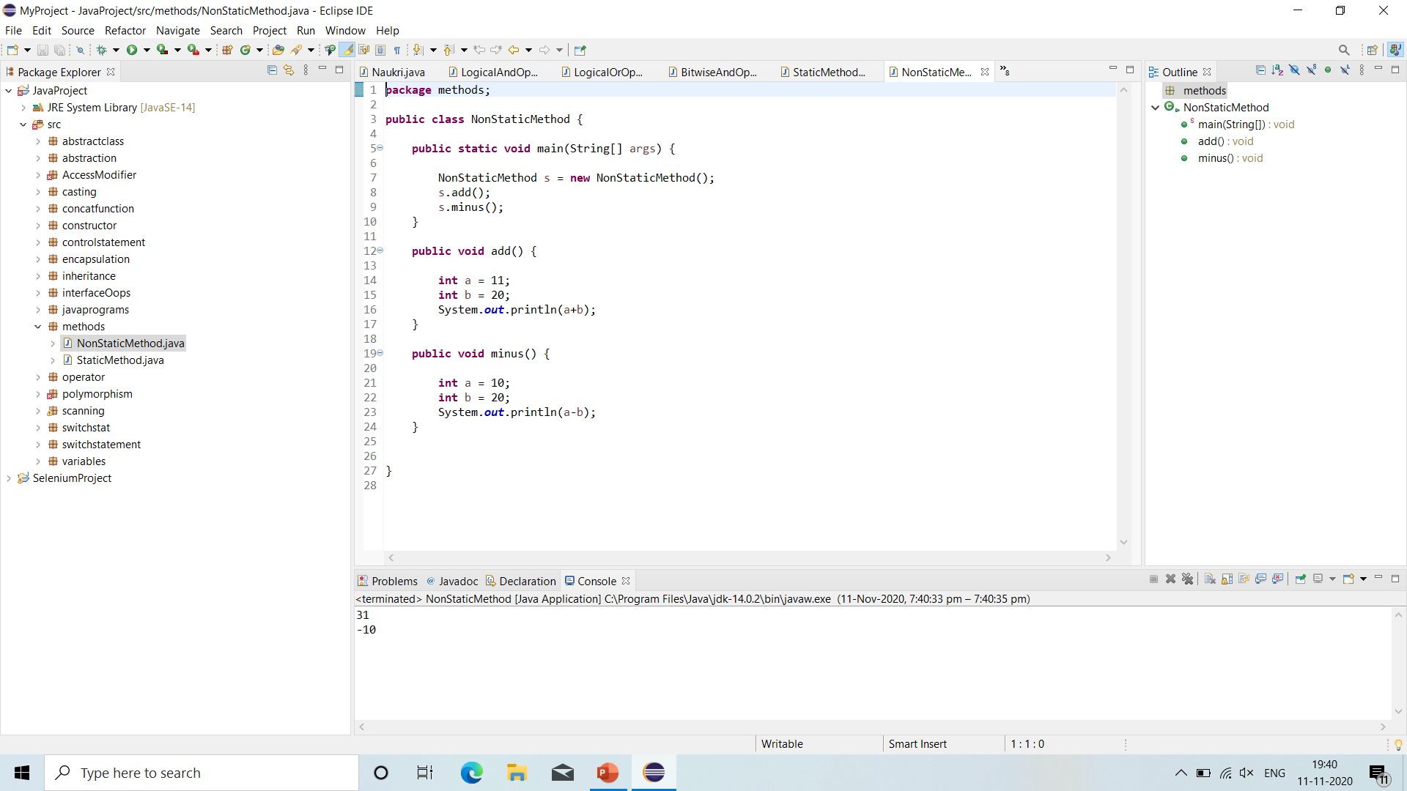
Non-static method

Slide 23
Java object creation
Object: Object is instance of class or Object is runtime entity.
Syntax:
Class Name Reference Variable(Object) = New(Keyword) Constructor();
Example:
GoodMorning a = new GoodMorning();
Here,
GoodMorning = Name of the class.
a = Object reference variable which stores the address of an object.
New = Keyword that stores the object in Heap memory.
GoodMorning = Constructor of the class. Name is same as that of the class. It will load members of Non Static Methods.
‘=‘ = It is assignment operator which take the object created by new keyword and assign it to the reference variable.

Slide 24
Java variable and data type
Variable: Variable is nothing but piece of memory used to store the information.
Syntax:
Data Type Variable Name = Information(Value);
Data Type: Data type used to represent the type of information which we are going to use in java language.
There are 2 types of Data Type:
Primitive Data Type- Primitive data types are predefined and fixed. It always starts with lower case. Primitive data are only single value.
Non-Primitive Data Type- Non-primitive data type are created by the programmer and these are not fixed. Non-Primitive data type always starts with upper case. Non-primitive data used to store group of values.

Slide 25
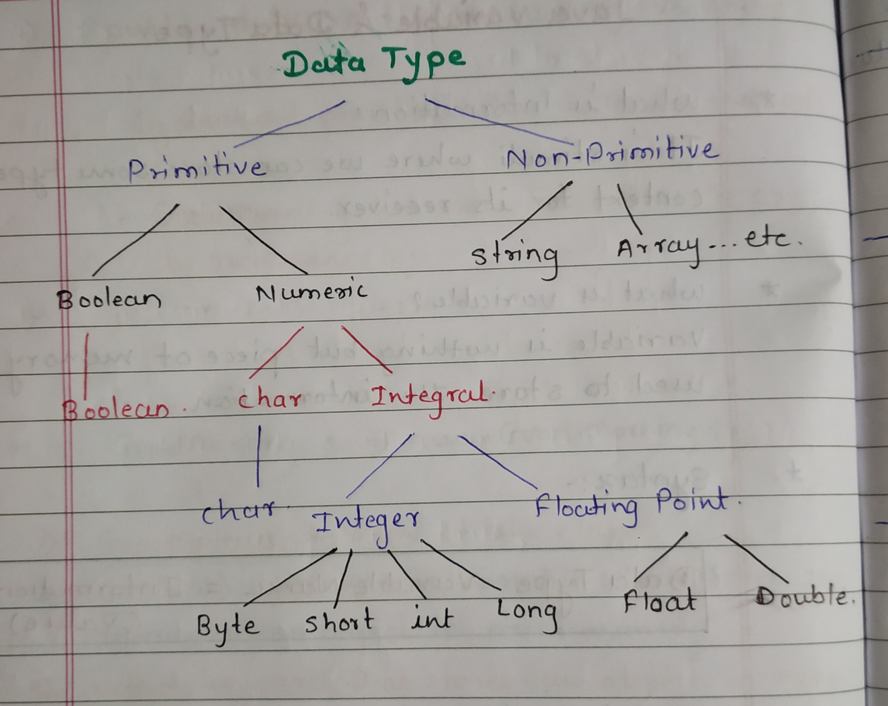
Java variable and data type

Slide 26
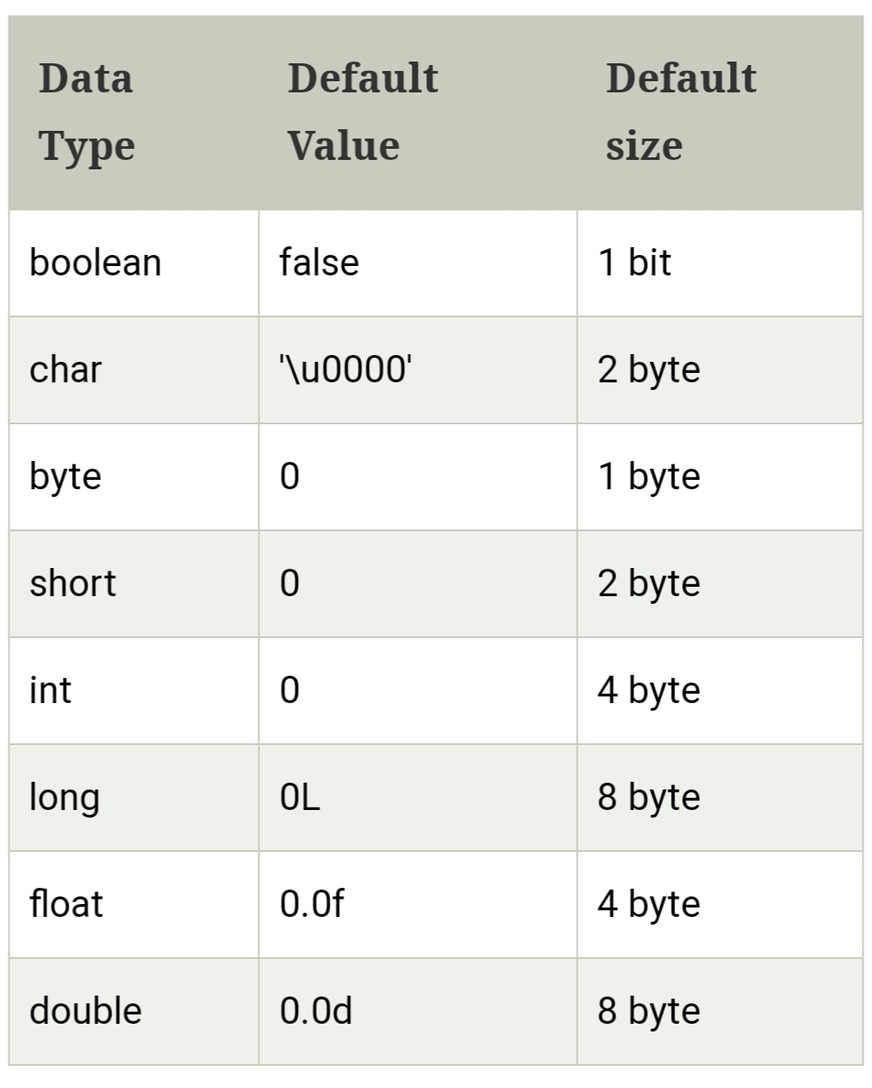
Java variable and data type
There are 8 types of Primitive Data Type:

Slide 27
Java types of variables
Java variables: A variables is a container which holds the value while java program is executed.
Variable is a name of memory allocation.
There are 3 types of variables in Java:
Local Variable: A variable declared inside the body of the method is called local variable. We can use that variable within that method only. A local variable cannot be define with ‘Static’ keyword.
Instance Variable: A variable declared inside the class but outside the body of the method is called instance variable. It is not declared as static.
Static Variable: A variable which is declared as static is called as static variable. It cannot be local. You can create single copy of static variable and share among all the instances of the class. Memory allocation for static variable happens only once when the class is loaded in the memory.

Slide 28
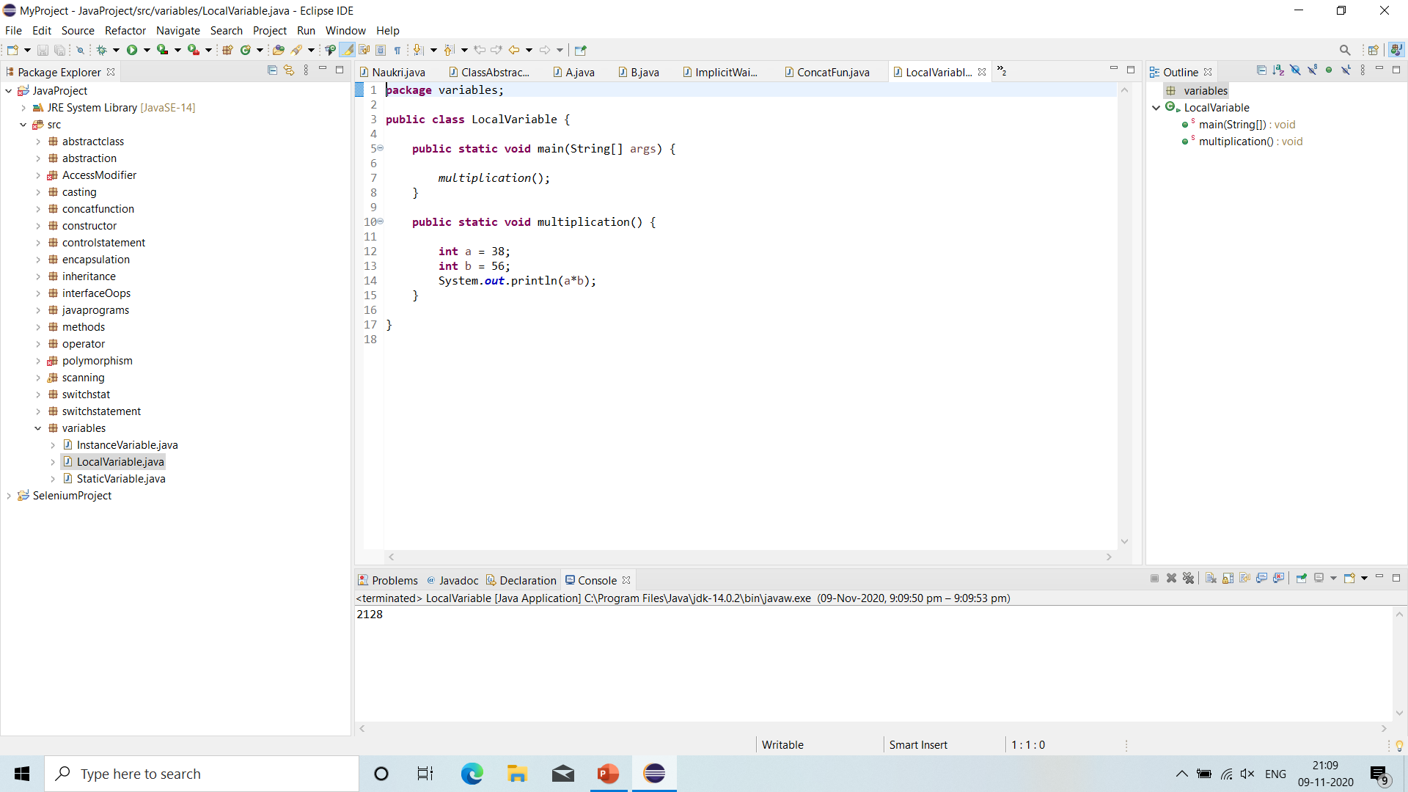
Local variable

Slide 29
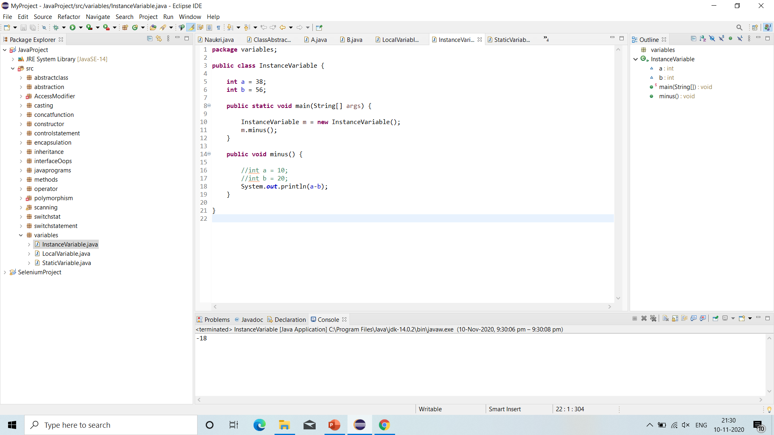
Global variable

Slide 30
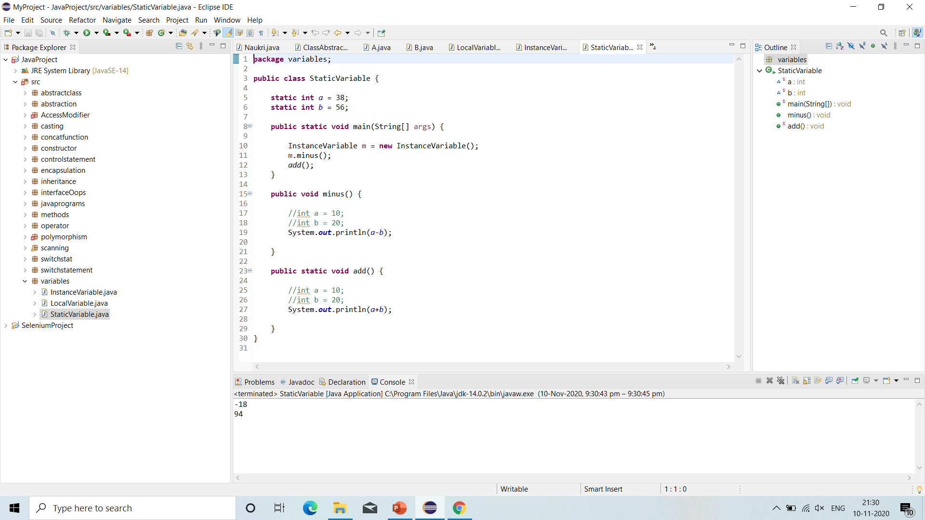
Static variable

Slide 31
constructors
In java, a constructor is a block of codes similar to the method. It is called when an instance of the class is created. At the time of calling constructor, memory for the object is allocated in the memory.
It is special type of method which is used to initialize the object.
Every time an object is created using the new() keyword, at least one constructor is called.
It calls default constructor if there is no constructor available in the class. In such case, Java compiler provides a default constructor by default.
Rules for creating Java constructor:
Constructor name must be the same as its class name.
A constructor must have no explicit return type.
A java constructor cannot be abstract, static, final and synchronized.

Slide 32
constructors
There are two types of constructors in java:
Default Constructor (No-Arguments Constructor).
Parameterized Constructor.
Java Default Constructor:
A constructor is called ‘Default Constructor’ when it doesn’t have any parameter.
The default constructor is used to provide the default values to the object like 0, null, etc. depending on the type.

Slide 33
constructors
Java Parameterized Constructor:
A constructor which has a specific number of parameters is called a parameterized constructor.
The parameterized constructor used to provide different values to distinct objects. However, you can provide the same values also.
Constructor Overloading:
In java, a constructor is just like a method but without return type. It can also be overloaded like java methods.
Constructor overloading in java is a technique of having more than one constructor with different parameter lists. They are arranged in a way that each constructor performs a different task. They are differentiated by the compiler by the number of parameters in the list and their types.

Slide 34
constructors
Does constructor return any value:
Yes, it is the current class instance (You cannot use return type yet it returns a value).
Is there constructor class in java?
Yes.
Can constructor perform other tasks instead of initialization?
Yes, like object creation, starting a thread, calling a method, etc. You can perform any operation in the constructor as you perform in the method.
What is the purpose of constructor class?
Java provides a constructor class which can be used to get the internal information of a constructor in the class. It is found in the java.lang.reflect package.
We can have private, protected, public and default constructor in java.

Slide 35
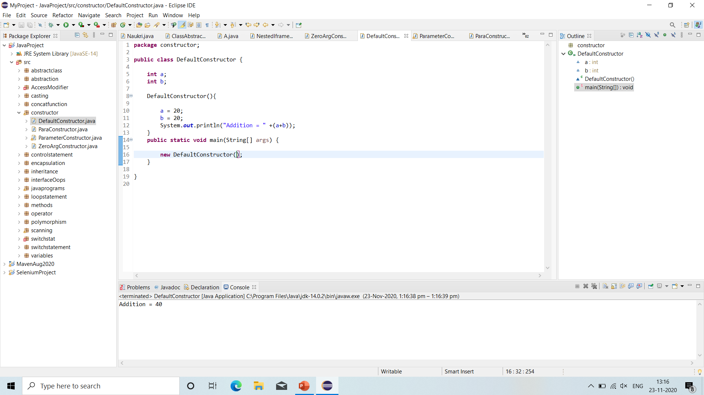
Default constructor

Slide 36
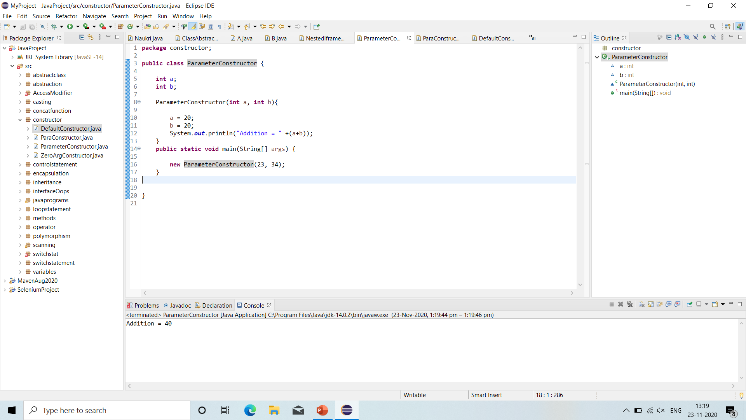
Parameterized constructor

Slide 37
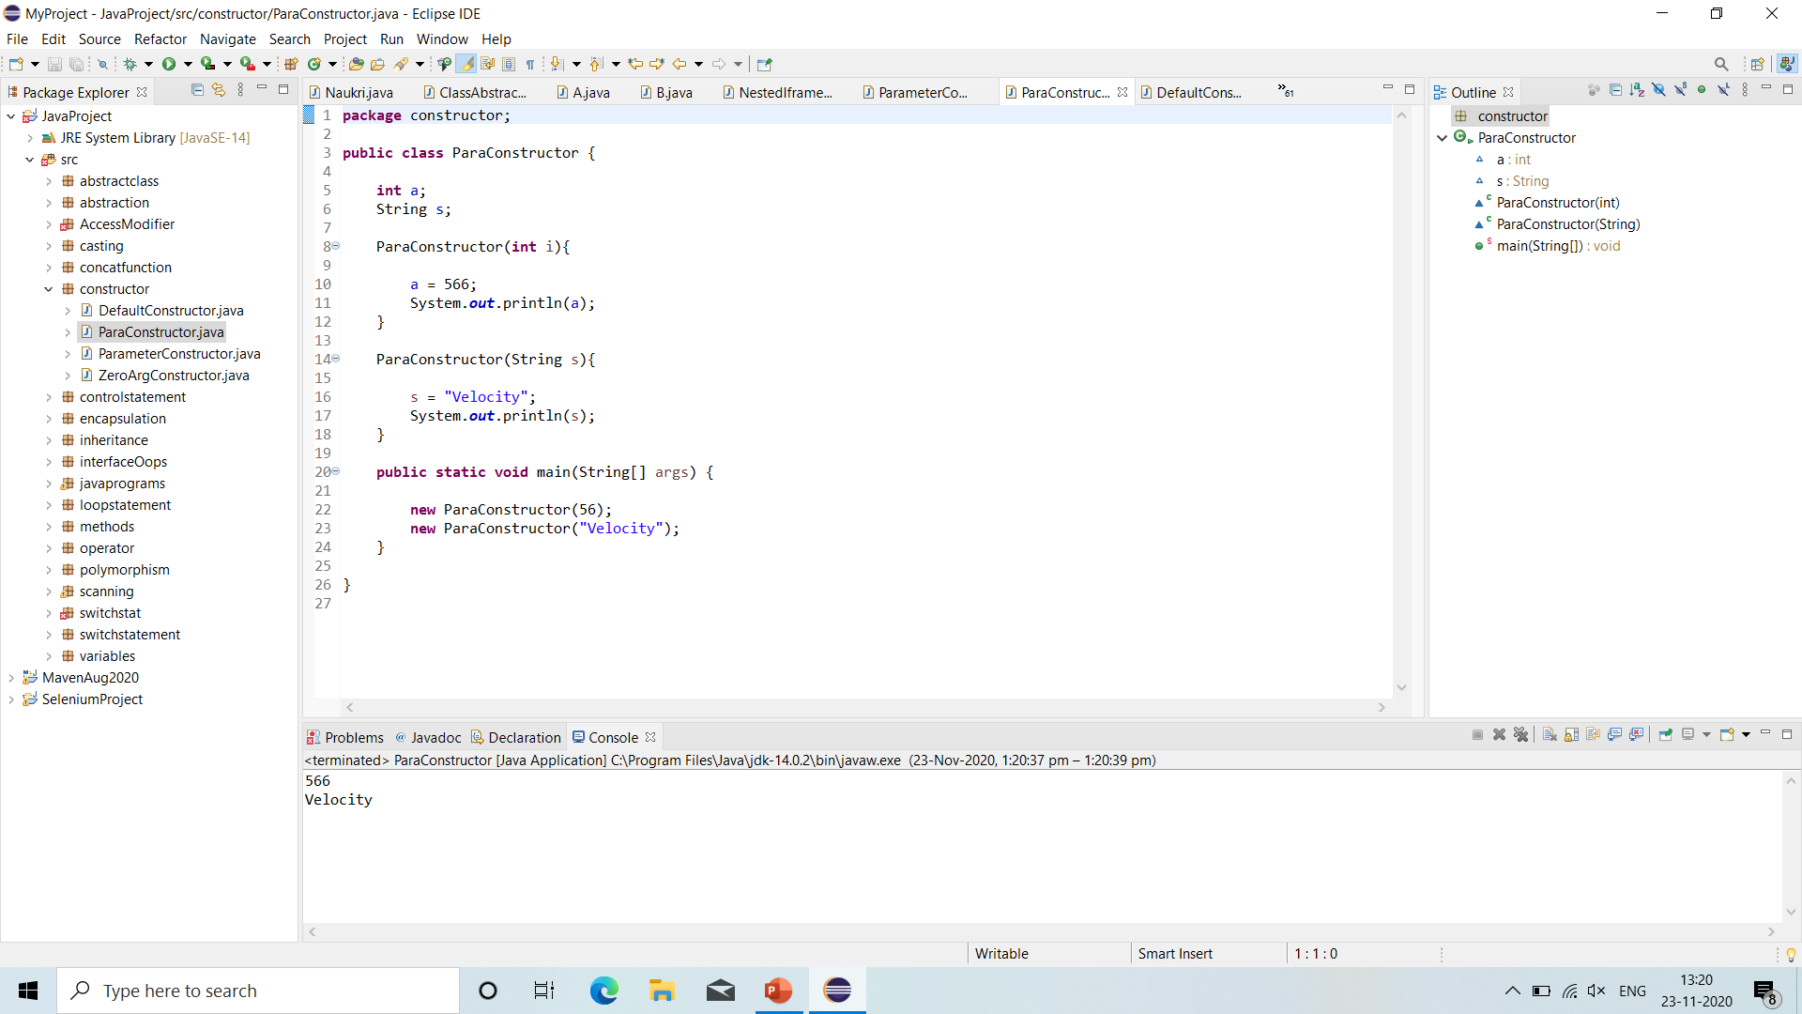
Constructor overloading

Slide 38
Some tricks in java
‘+’ Sign: If you want to join two or more statements or for multiple outputs we use ‘+’ sign.
Difference between print() and println():
print():
The print method simply print text on the console and does not add any new line.
Print method is implemented as it prints the text on console and the cursor remains at the end of text at the console.
println():
Println adds new line after print text on console.
Println method is implemented as prints the text on console and cursor remains at the start of the next line at console and next printing takes place from next line.

Slide 39
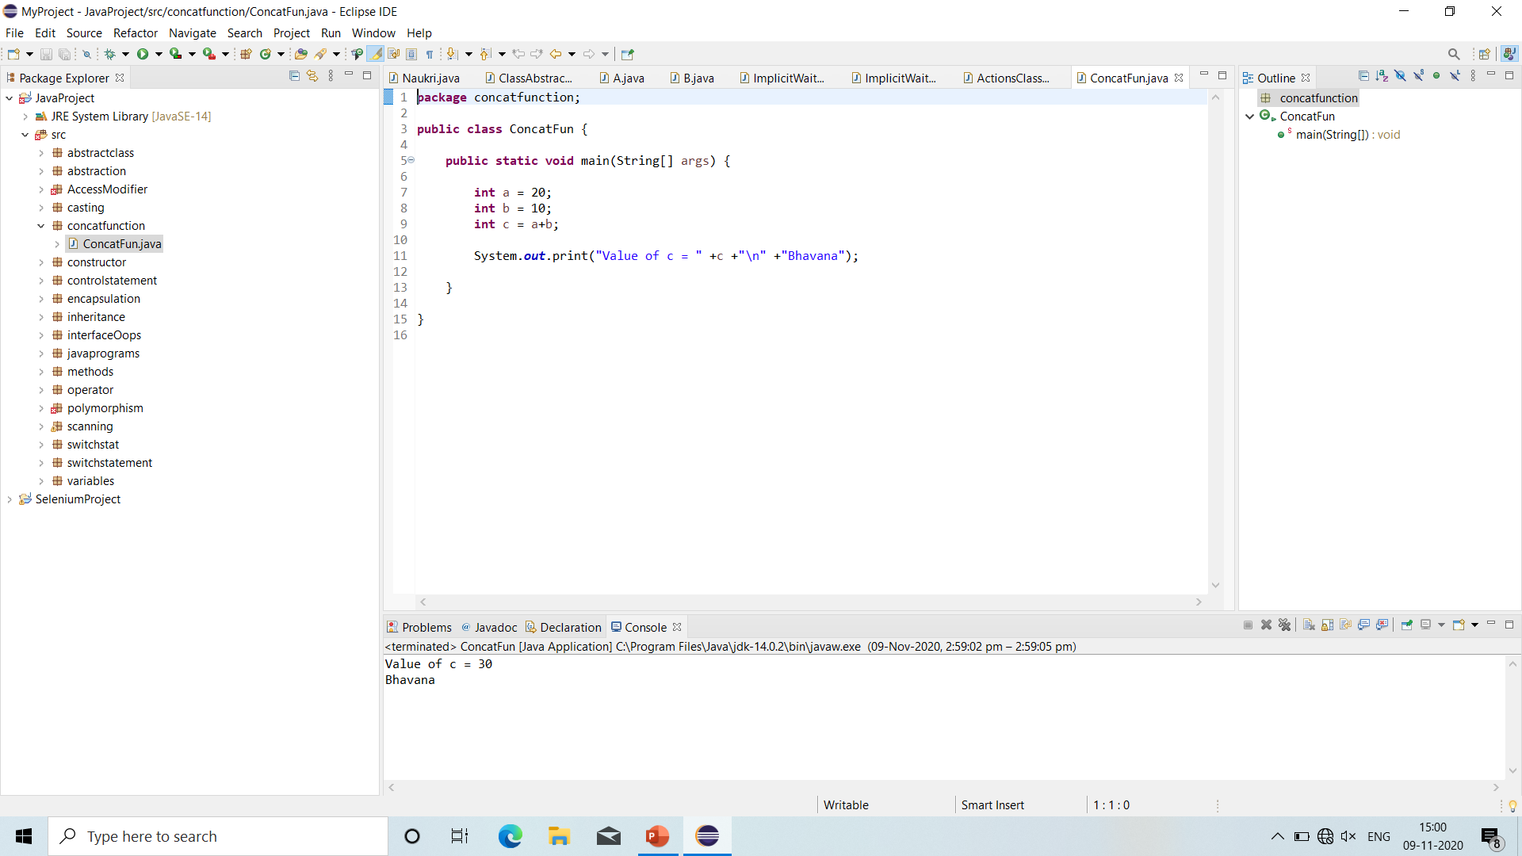
‘+’ sign

Slide 40
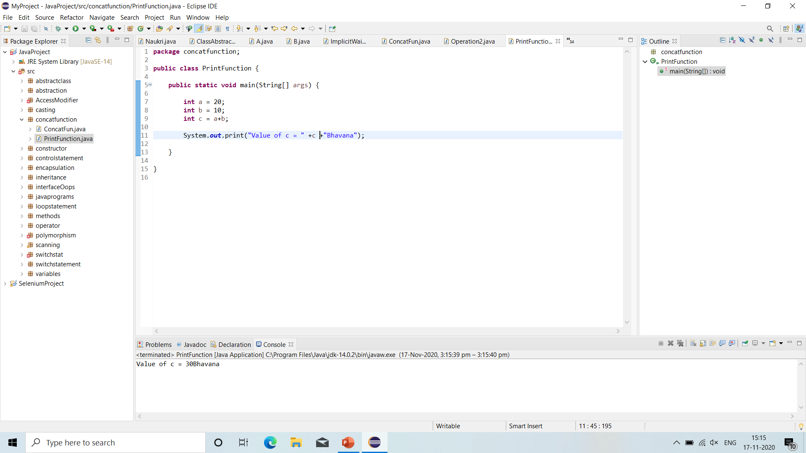
Print method

Slide 41
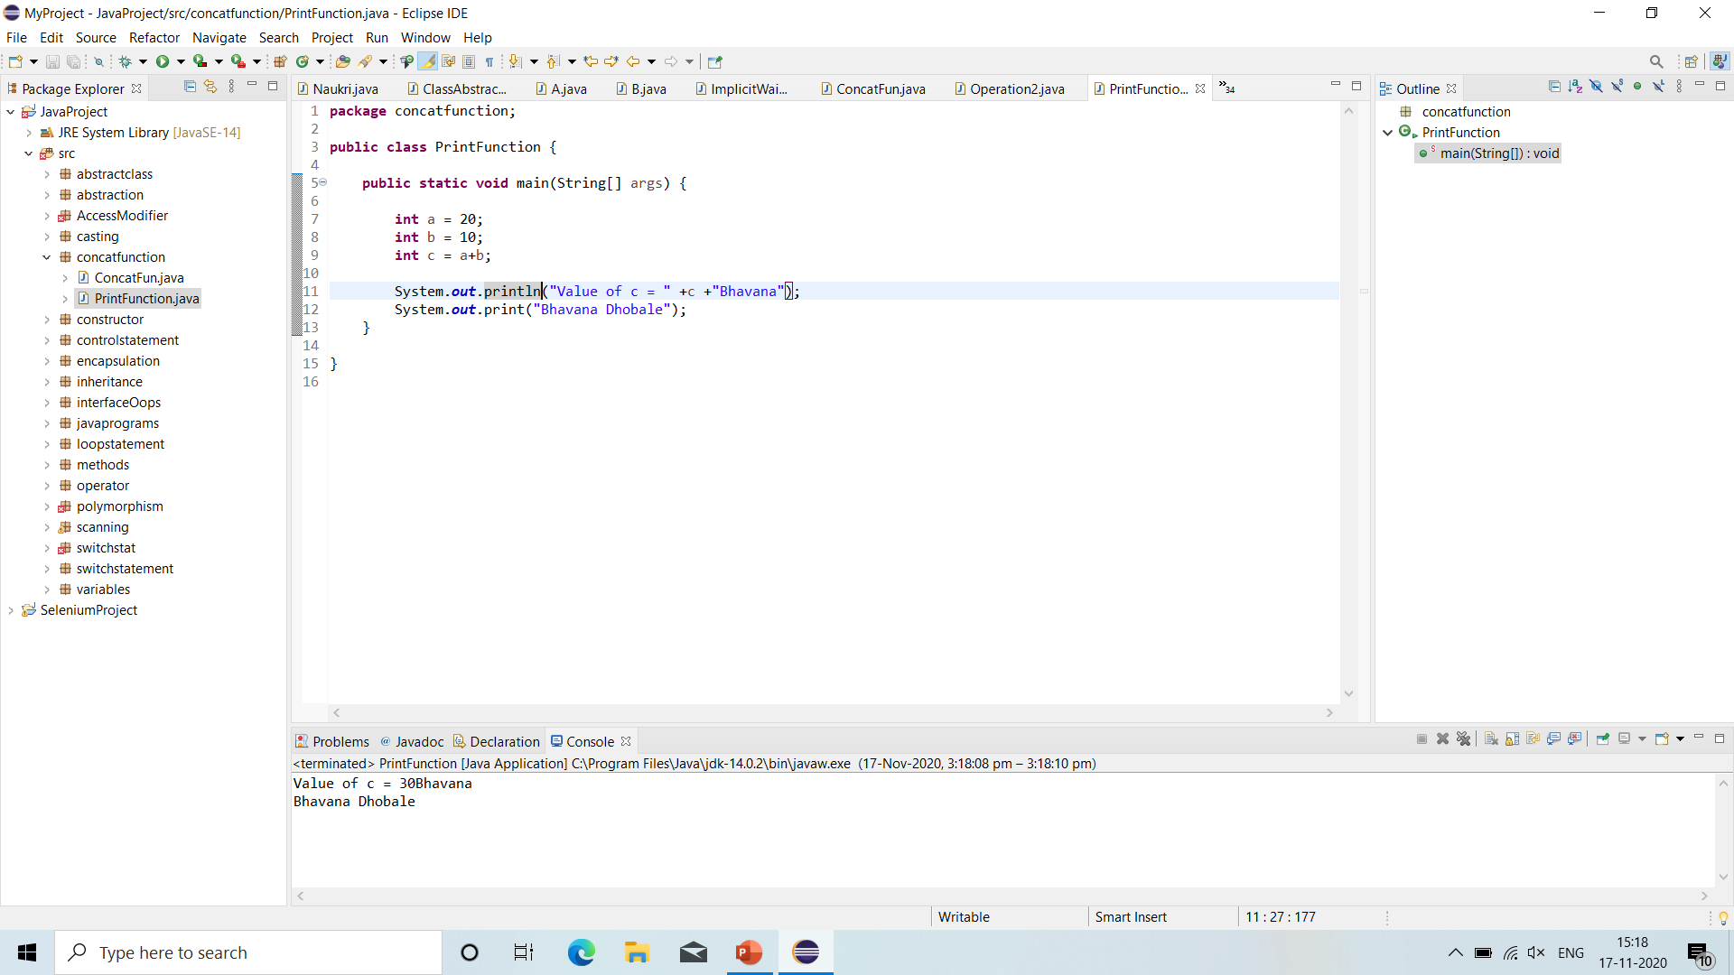
Print and println method

Slide 42
Java operators
Operator: Operator in java is a symbol which is used to perform operations. Example: +, -, *, /, %.
There are many types of operators in java:
Unary Operator
Arithmetic Operator
Shift Operator
Bitwise Operator
Logical Operator

Slide 43
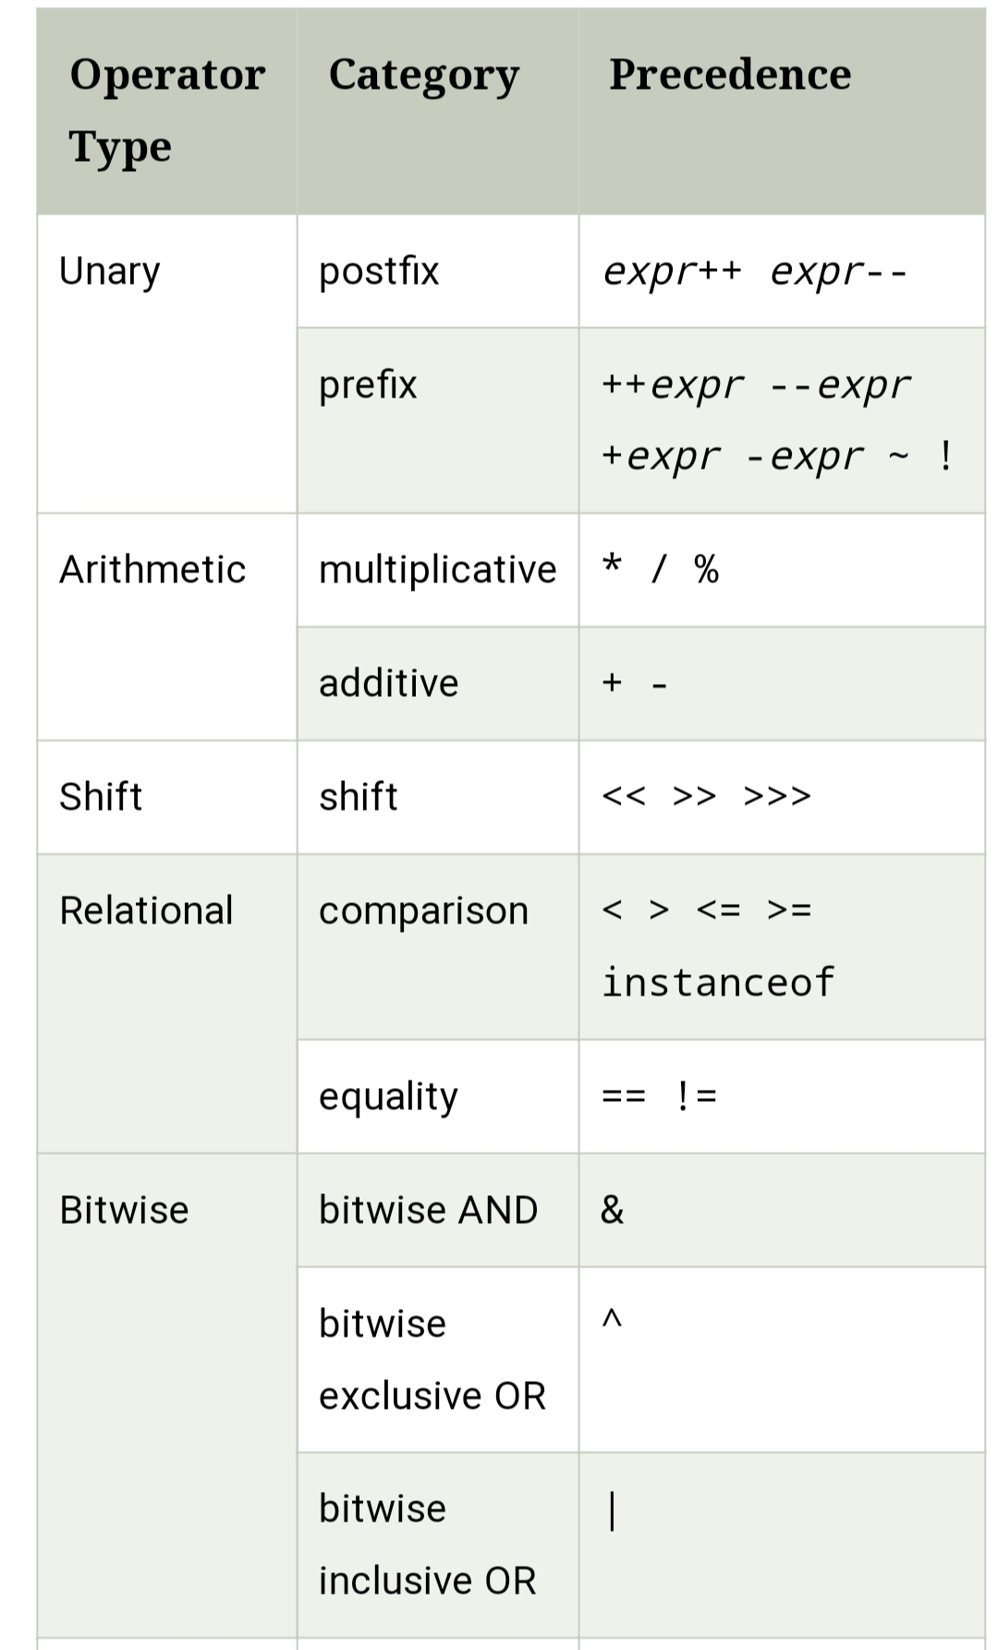
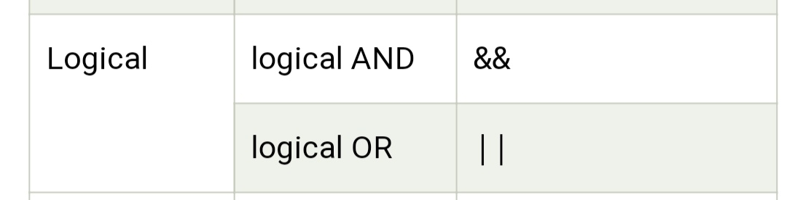
Java operators

Slide 44
Java operators
1. Unary Operator:
Unary operators are used to perform various operations i.e. incrementing and decrementing a value by one.
Postfix: exp++ and exp- -
Prefix: ++exp and - -exp
2. Arithmetic Operator:
- Java arithmetic operators are used to perform mathematical operations like Add, Subtract, Multiply, Divide.

Slide 45
Java operators
3. Shift Operators:
Left Shift Operator: Left shift operator is used to shift all of the bits in a value to the left side of specified number of time.
Right Shift Operator: Right shift operator is used to move left operands value to the right by the number of bits specified by the right operand.
4. Logical Operator:
Logical && Operator: The logical && operator doesn’t check second condition if first condition is false. It checks second condition only if first one is true.
Logical || Operator: The logical || operator doesn’t check second condition if first condition is true. It checks second condition only if first one is false.

Slide 46
Java operators
5. Bitwise Operators:
Bitwise & Operator: The bitwise & operator always checks both conditions whether first condition is true or false.
Bitwise | Operator: The bitwise | operator always checks both conditions whether first condition is true or false.

Slide 47
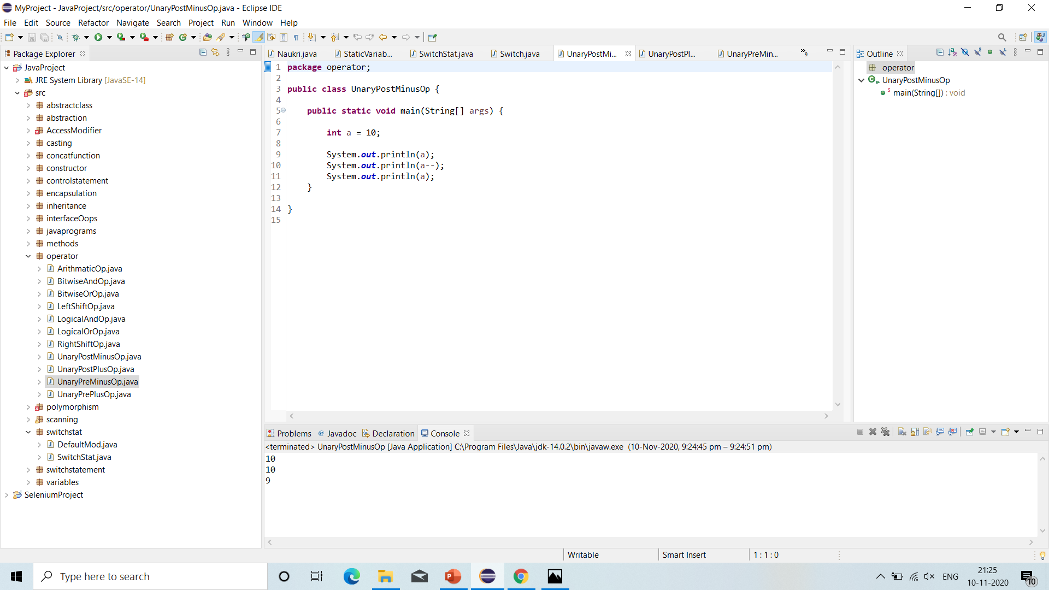
Unary post minus operator

Slide 48

Unary post plus operator

Slide 49

Unary pre minus operator

Slide 50

Unary pre plus operator

Slide 51
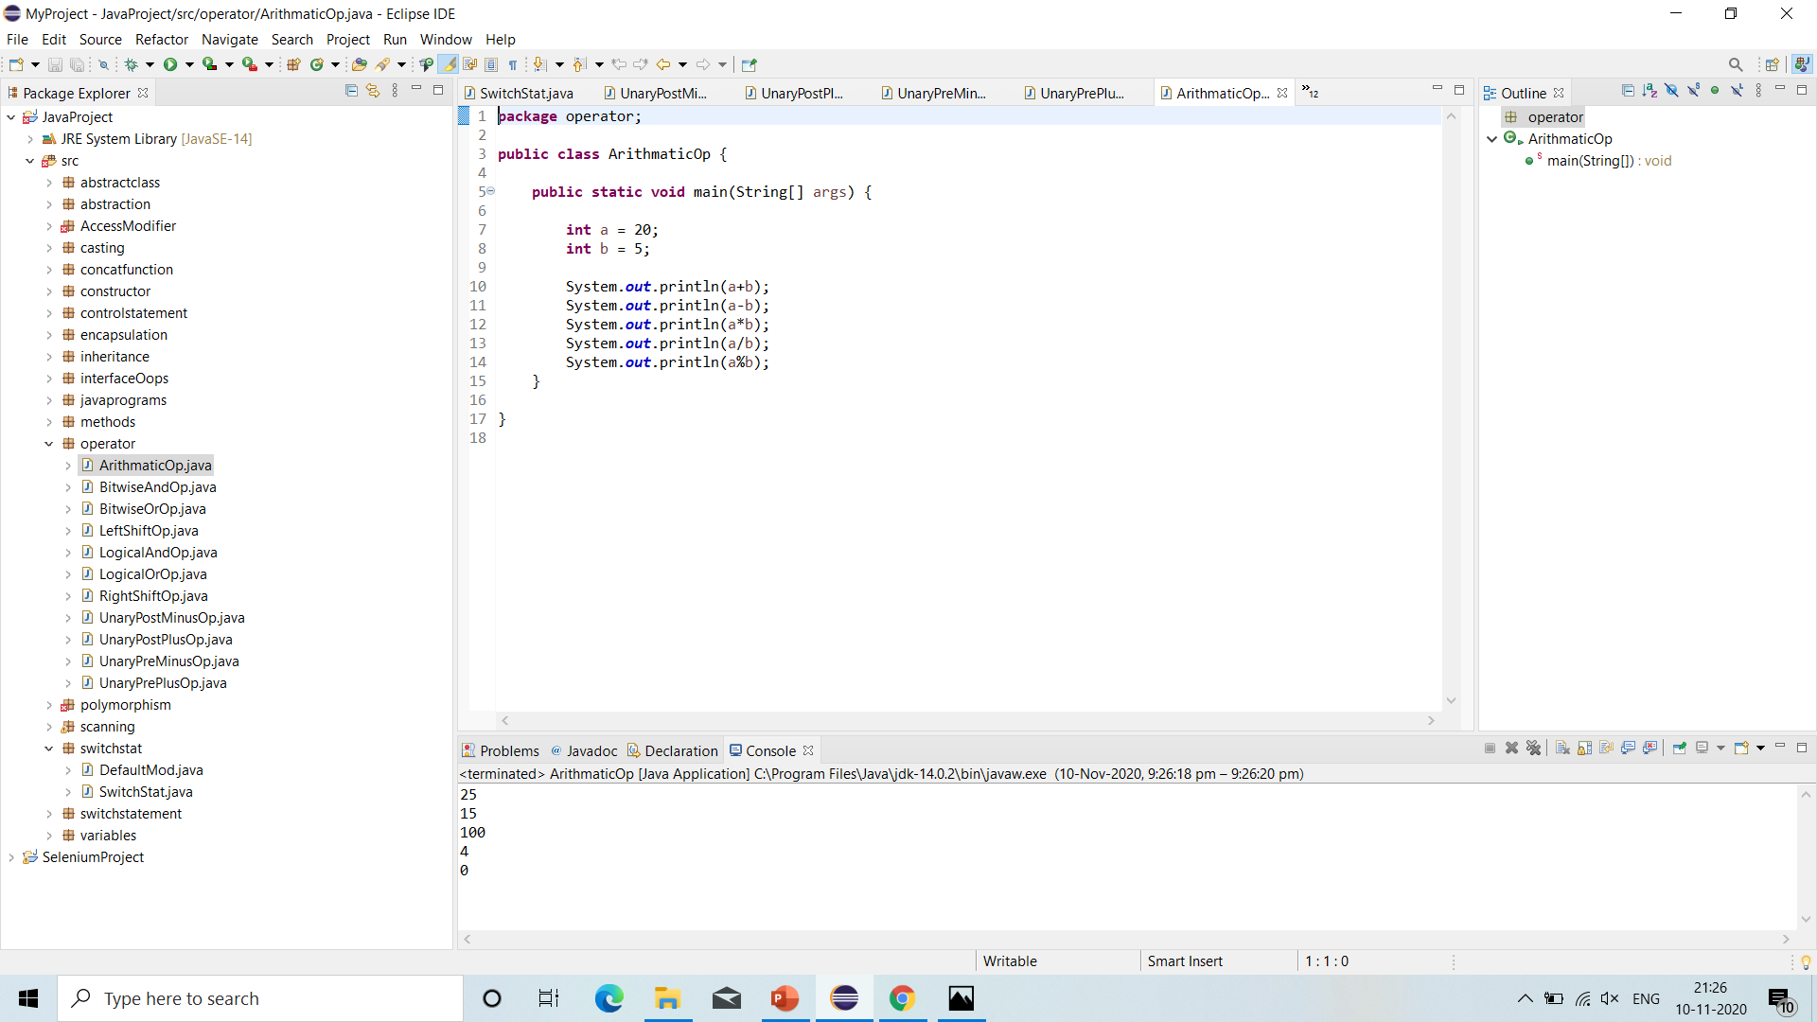
Arithmetic operators

Slide 52
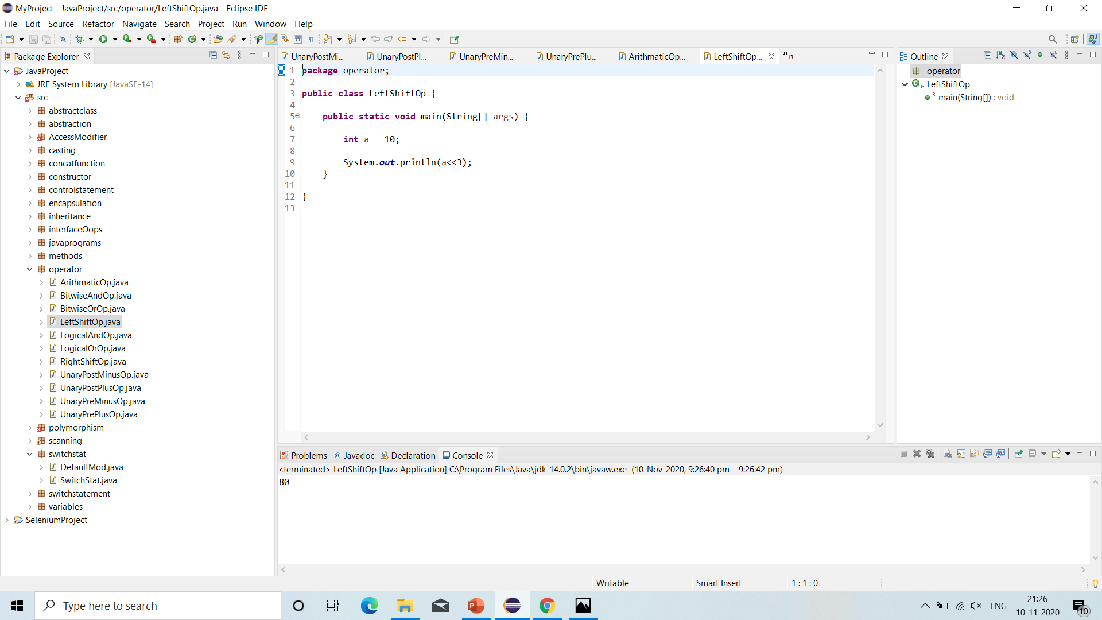
Left shift operator

Slide 53

Right shift operator

Slide 54

Logical && operator

Slide 55
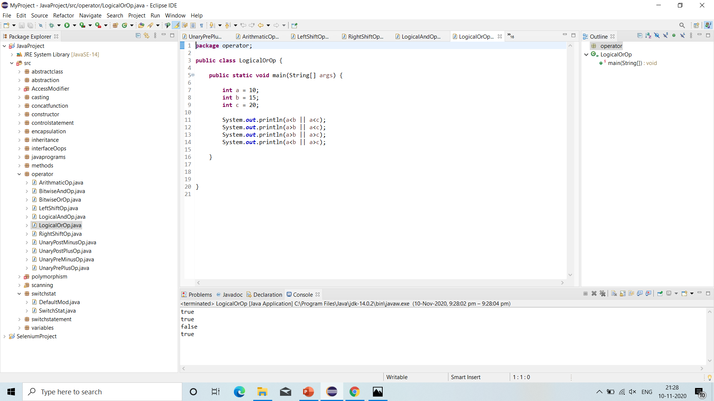
Logical || operator

Slide 56

Bitwise & operator

Slide 57

bitwise | operator

Slide 58
Loop statements
Loops: In programming languages, loops are used to execute a set of instructions repeatedly when some conditions become true.
There are 3 types of loops in java:
1. For Loop:
The java for loop is a control flow statement that iterates a part of the programs multiple times.
If the number of iteration is fixed, it is recommended to use for loop.
Syntax: for (initiation; condition; increment/decrement){
// code to be executed
}
It consists of 3 parts:
a. Initialization: It is the initial condition which is executed once when the loop starts.
b. Condition: It is the second condition which is executed each time to test the condition of the loop.
c. Increment/Decrement: It increments or decrements the variable value.

Slide 59
Loop statements
2. Java Nested For Loop:
If we have a for loop inside the another loop, it is known as nested for loop. The inner loop executes completely whenever outer loop executes.
3. While Loop:
The java while loop is used to iterate a part of the program several times.
If the number of iteration is not fixed, it is recommended to use while loop.
Syntax:
while(condition){
// code to be executed
}

Slide 60
Loop statements
Java Do-While Loop:
The java do-while loop is used to iterate a part of the program several times.
If the number of iteration is not fixed and you must have to execute the loop at least once, it is recommended to use do-while loop.
The java do-while loop is executed at least once because condition is checked after loop body.
Syntax:
do{
// code to be executed
} while (condition);

Slide 61
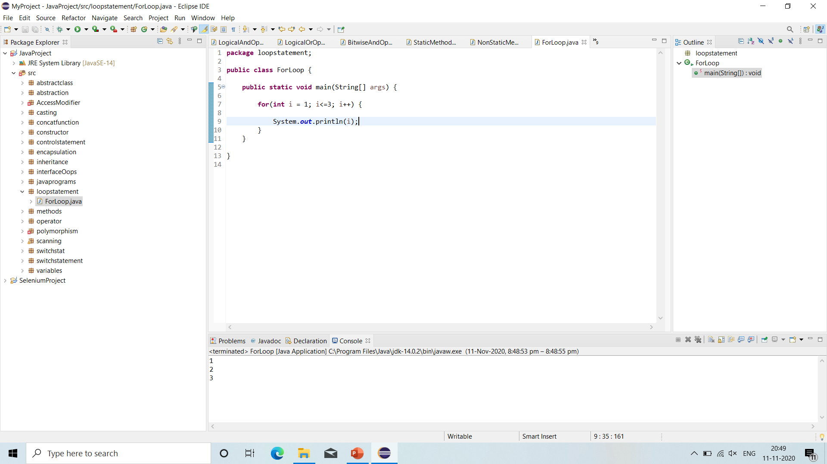
For loop

Slide 62
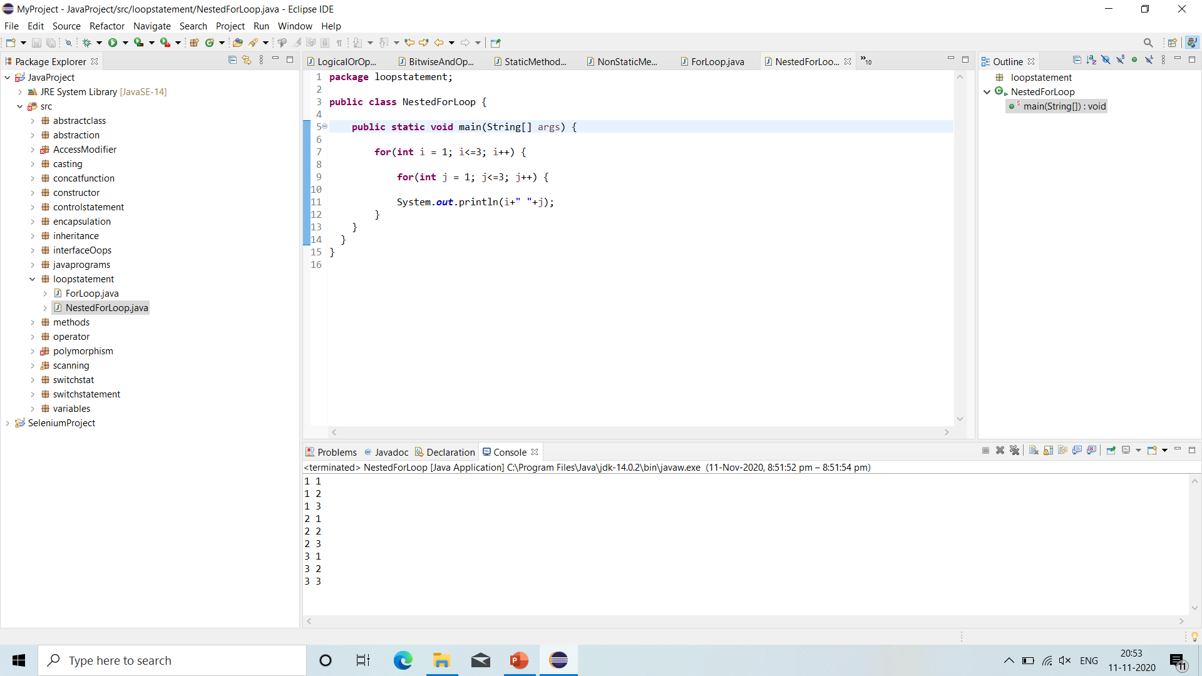
Nested for loop

Slide 63
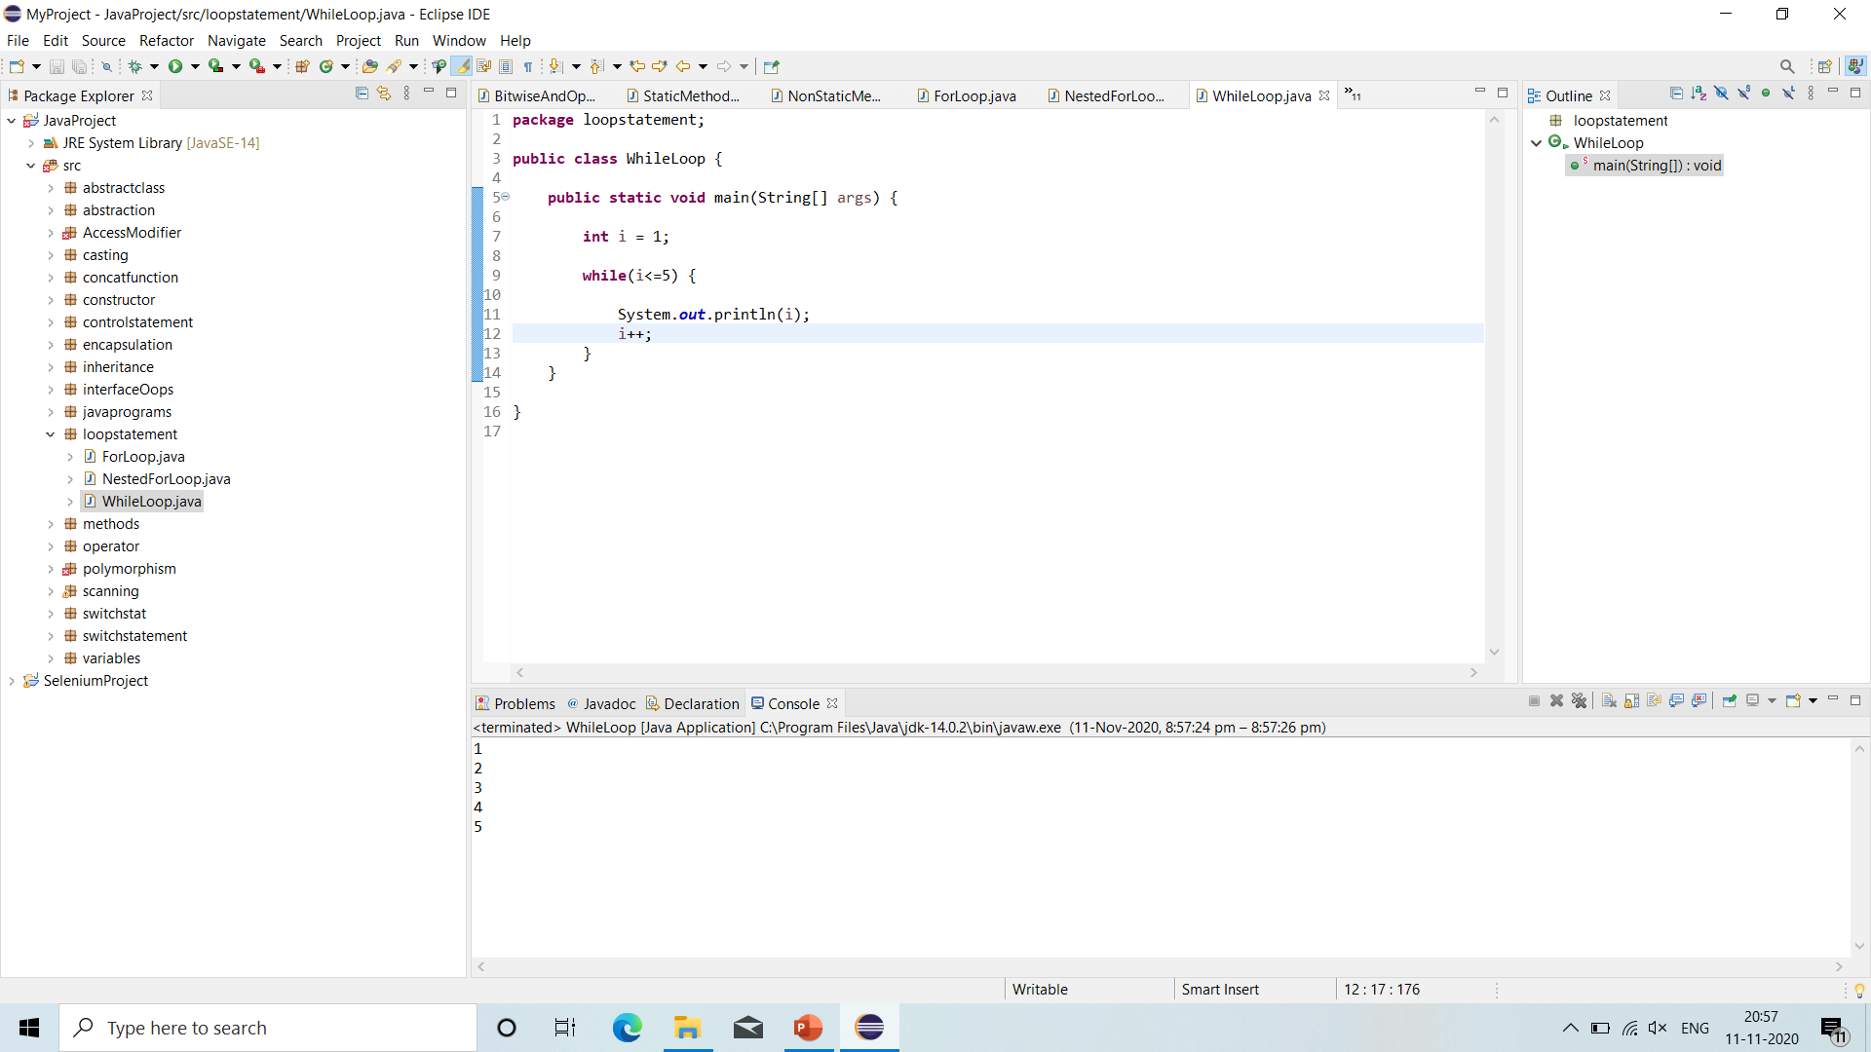
While loop

Slide 64

Do-while loop

Slide 65
Control statements
Control Statements: The control statements are nothing but conditional statements use to execute a set of statements based on condition or situation.
Control statements are:
‘IF’ Statement: The java if statement tests the condition. It executes the ‘if’ block if condition is true.
‘IF-ELSE’ Statement: The java ‘if-else’ statement also tests the condition. It executes the ‘if’ block if condition is true otherwise ‘else’ block is executed.
‘IF-ELSE-IF’ Statement: ‘If-else-if’ ladder statement executes one condition from multiple statements.
‘Nested-IF Statement: The nested if statement represents the if block within another if block. Here, the inner if block condition executes only when outer if block condition is true.
‘Nested-IF-ELSE Statement: It will execute inner block of IF-ELSE statement when outer if condition is true. Otherwise it will execute else block within which IF-ELSE statement is present.

Slide 66
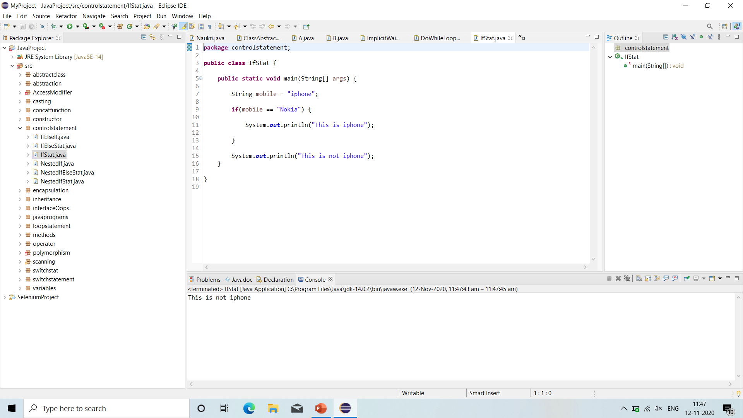
if statement

Slide 67
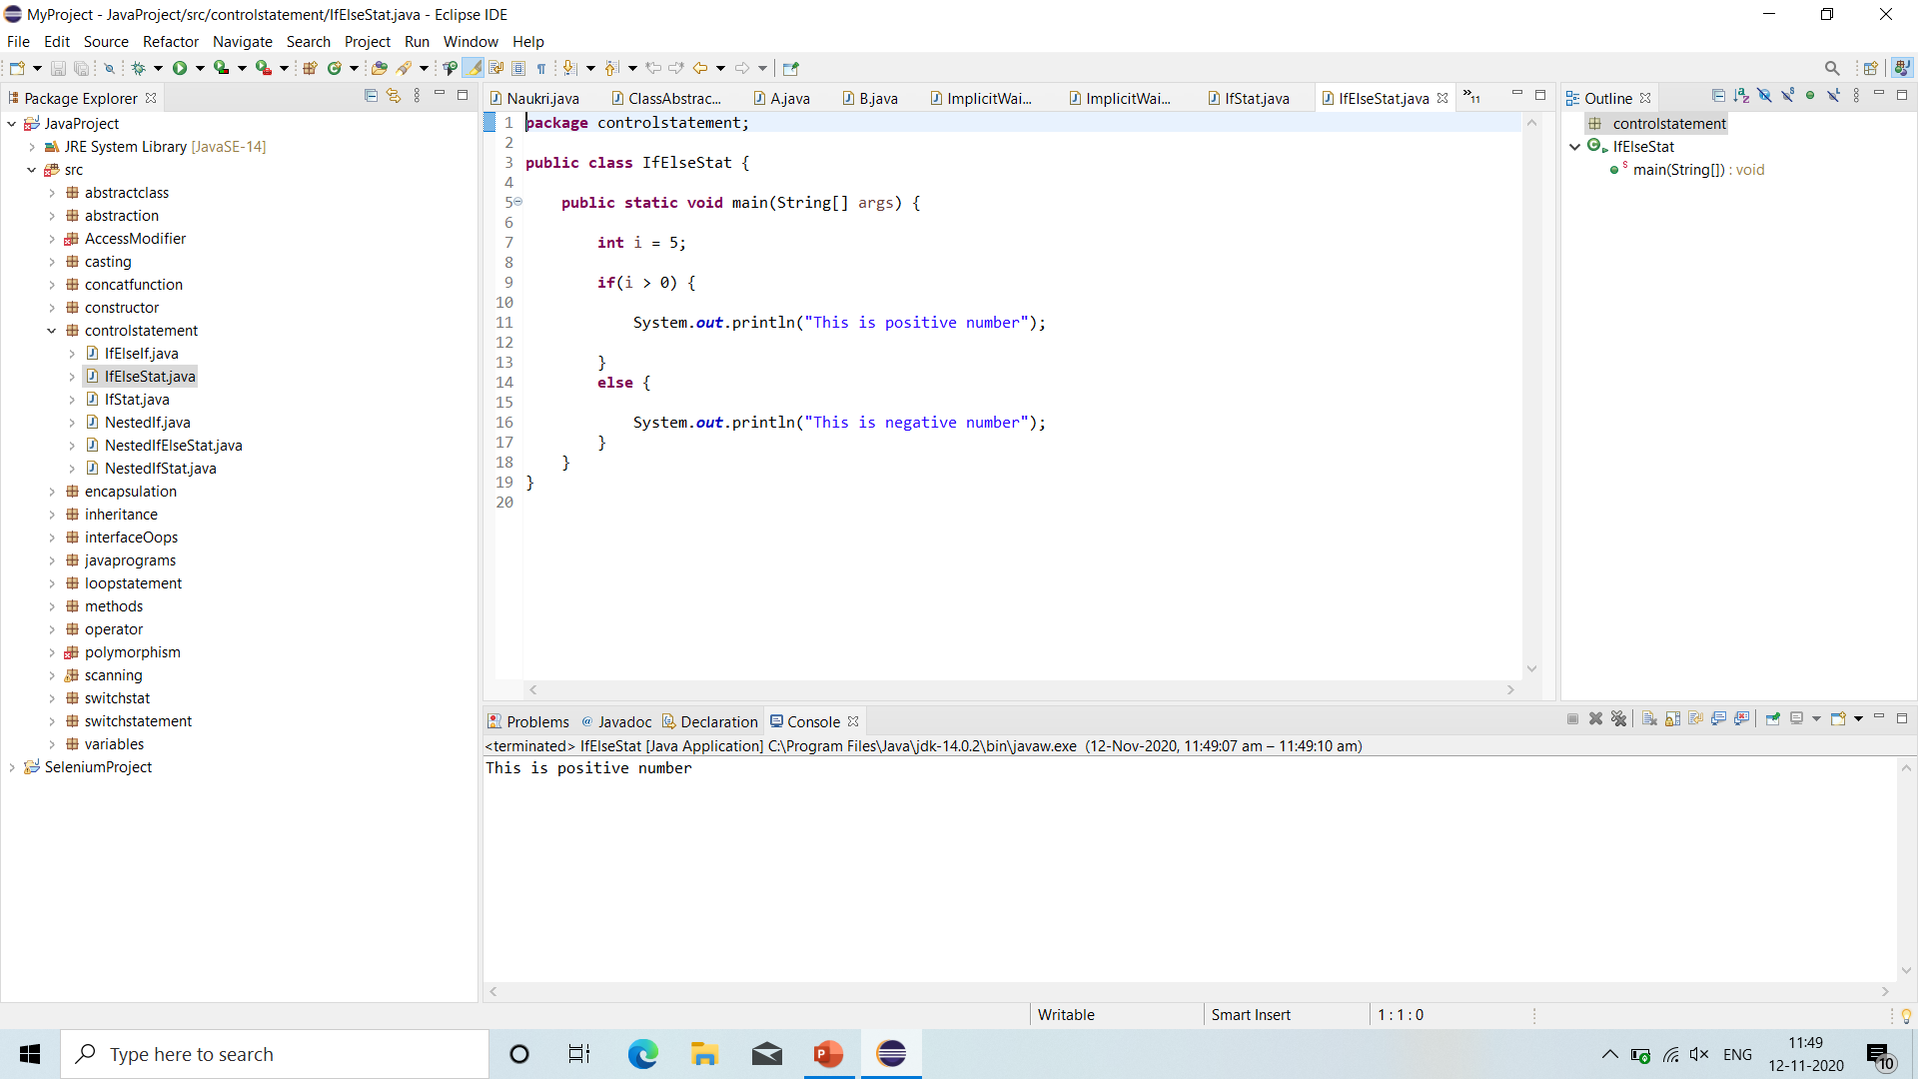
If-else statement

Slide 68
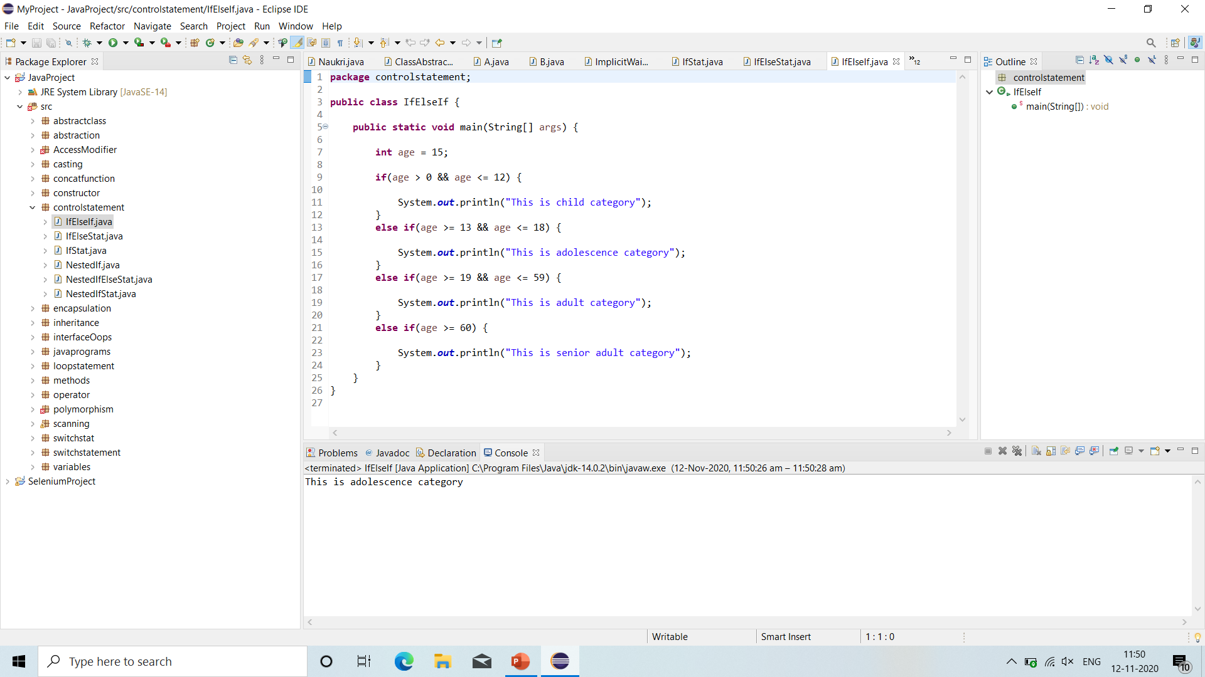
If-else-if statement

Slide 69
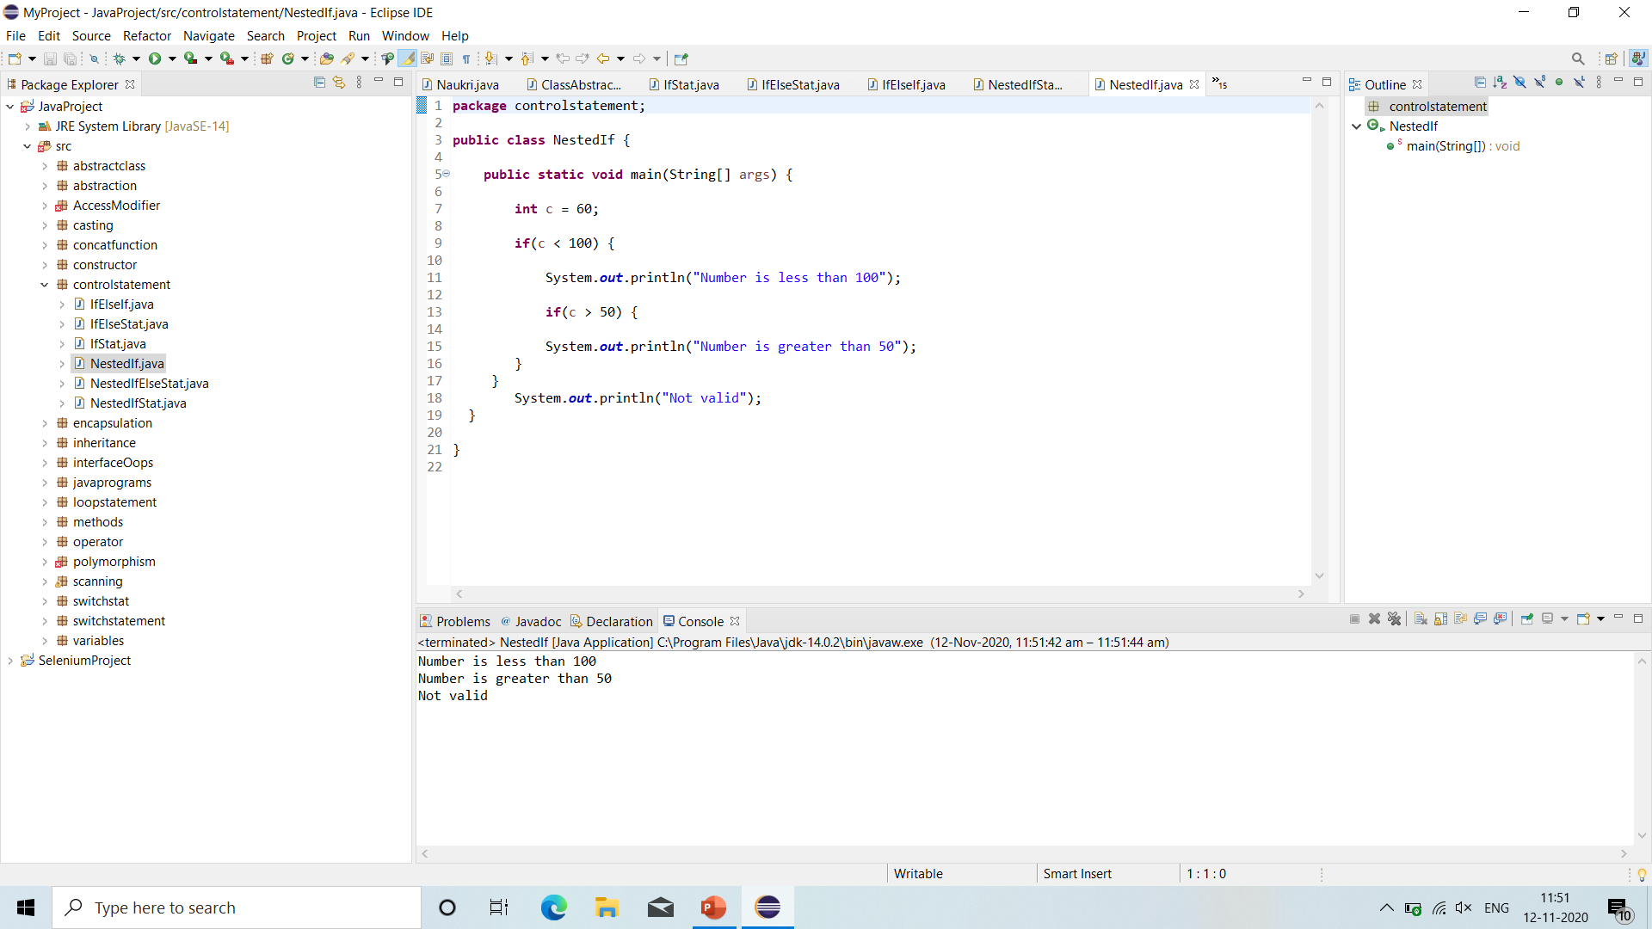
Nested-if statement

Slide 70
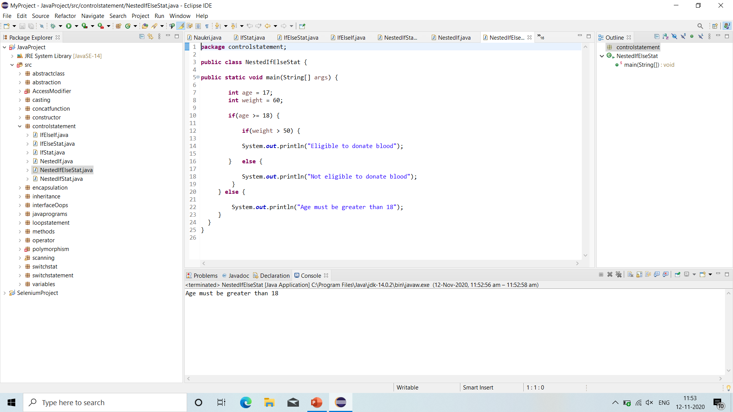
Nested-if-else statement

Slide 71
Switch statement
The java switch statement execute one statement from multiple conditions. In other words, The switch statement tests the equality of a variable against multiple values.
There can be one or N number of case values for switch expression.
The case value must be of switch expression type only. The case value must be constant.
The case value must be unique. In case of duplicate value, it gives Compile-time error.
Each case statement can have break statement. When control reaches to the break statement, it jumps the control after the switch expression. If the break statement is not found, it executes the next case.
BREAK: Java break is keyword is used to break loop or switch statement. It breaks the current flow of the program at specified condition.
CASE: Java case keyword is used with switch statement to mark blocks of text.
DEFAULT: Java default keyword is used to specify the default block of code in switch statement.
SWITCH: The java switch keyword contains switch statement that executes code based on test value.

Slide 72
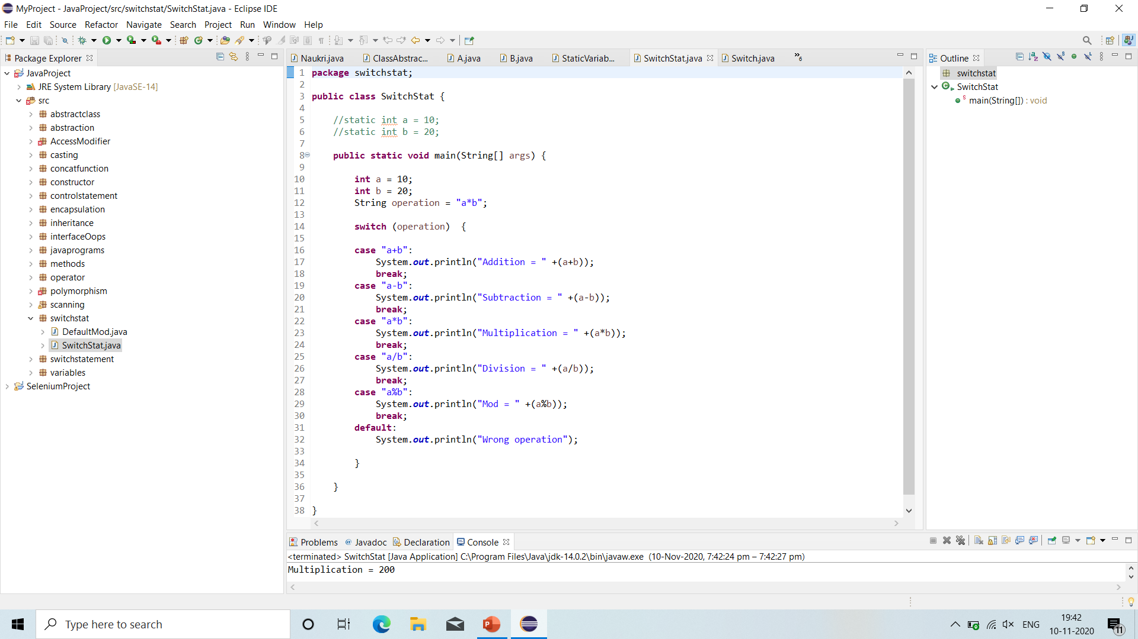
Switch statement

Slide 73
array
C/C++.
An array is a collection of similar type of elements which has contiguous memory location.
Java array is an object which contains elements of a similar data type.
The elements of an array are stored in a contiguous memory location.
It is a data structure where we store similar elements.
We can store only a fixed set of elements in a Java array.
Array in Java is index-based, the first element of the array is stored at the 0th index, 2nd element is stored on 1st index and so on.

Slide 74
array
Advantages
Code Optimization: It makes the code optimized, we can retrieve or sort the data efficiently.
Random access: We can get any data located at an index position.
Disadvantages
Size Limit: We can store only the fixed size of elements in the array. It doesn't grow its size at runtime. To solve this problem, collection framework is used in Java which grows automatically.
Dynamic array is not possible.
In an array only Homogeneous Information we are able to store.

Slide 75
array
Before Array: We save Name (String) with variable like,
String name = “abc”;
But now in array we use.
String name;
name = “xyz”;
Declaration of Array Variables: For declaring an array we have 3 steps.
Declaring an Array: int Array[ ];
Constructing an Array: String arr[ ] = new String[5];
Initialize an Array: arr[0] = Value;

Slide 76
array
Types of Array in java
1. Single Dimensional Array
2. Multidimensional Array
Single Dimensional Array: Single Dimensional Array can store one column data i.e. Homogeneous data.
Array index start from ‘0’.
Syntax: datatype arr [ ];
Initiation of an Array:
String arr[ ] = new String [size];
Here, String = Datatype
arr [ ] = Array Name and Array Sign
new = Empty array create with given size
[size] = String type array size

Slide 77
array
In multidimensional array, data is stored in row and column based index.
In multidimensional array we do Declaration with Initialization in one step.
In single dimension we have to do Declaration and Initialization in two steps so we overcome this in multidimensional array.
We have to import “java.util.Arrays” file for using Arrays.
Multidimensional arrays are actually arrays of arrays.
To declare a multidimensional array variable, specify each additional index using another set of square brackets.
Syntax:
int arr [ ][ ] = new int [4][5];

Slide 78
array
When you allocate memory for a multidimensional array, only need to specify the memory for the first (leftmost) dimension.
We are able to allocate the remaining dimensions separately.
In java, array length of each array in a multidimensional array is in our control.
In Single Dimensional Array:
int a[ ] = new a[5]; // Declaration
a[0] = 10; // Initialization
In Multidimensional Array:
int a[ ] = {10, 20, 30, 40} // Declaration and Initialization in one step.

Slide 79
map
A map contains values on the basis of key, i.e. key and value pair. Each key and value pair is known as an entry. A Map contains unique keys.
A Map is useful if you have to search, update or delete elements on the basis of a key.
There are two interfaces for implementing Map in java: Map and SortedMap, and three classes: HashMap, LinkedHashMap, and TreeMap.
A Map doesn't allow duplicate keys, but you can have duplicate values. HashMap and LinkedHashMap allow null keys and values, but TreeMap doesn't allow any null key or value.
A Map can't be traversed, so you need to convert it into Set using keyset() or entrySet() method.

Slide 80
map
HashMap = HashMap is the implementation of Map, but it doesn't maintain any order.
LinkedHashMap = LinkedHashMap is the implementation of Map. It inherits HashMap class. It maintains insertion order.
TreeMap = TreeMap is the implementation of Map and SortedMap. It maintains ascending order.

Slide 81
collection
The Collection in Java is a framework that provides an architecture to store and manipulate the group of objects.
Java Collections can achieve all the operations that you perform on a data such as searching, sorting, insertion, manipulation, and deletion.
A Collection represents a single unit of objects, i.e., a group.
Java Collection means a single unit of objects. Java Collection framework provides many interfaces (Set, List, Queue, Deque) and classes (ArrayList, Vector, LinkedList, PriorityQueue, HashSet, LinkedHashSet, TreeSet).

Slide 82
collection
Collection:
List (I)
Set (I)
Queue (I)
List:
Duplicate are allowed in list.
Allows any no of Null values.
Order of insertion maintained.
Types of List: ArrayList (IC)
Vector (IC)
LinkedList (IC).

Slide 83
collection
Set:
Doesn’t allow duplicate.
Allow only one null value (Except tree set).
Order of insertion- Random insertion.
Types of Set: HashSet (IC)
LinkedHashSet (IC)
TreeSet (IC)
Queue: PriorityQueue (IC)
Cursor:
Iterator: All the collection object --- Universal Cursor.
ListIterator: Only for list interface type impl classes --- Not Universal Cursor.
Enumeration: Legacy --- Universal Cursor.

Slide 84
collection
Arraylist:
Duplicate allow in Arraylist.
Allows any no of Null values.
Order of insertion maintained.
Default capacity for arraylist is 10.
Data structure – Resizable.
Incremental capacity = (Current capacity*3/2)+1.
Best choice: Retrieval operation (random access interface is implemented in arraylist and vector).
Worst choice: Manipulation operation i.e. insertion in between arraylist or delete()

Slide 85
collection
Vector:
Duplicate are allowed.
Allows any no of Null values.
Order of insertion maintained.
Default capacity for vector is 10.
Data structure – Doubly.
Incremental capacity = Current capacity*2.
Best choice: Retrieval operation (random access interface is implemented in arraylist and vector).
Worst choice: Manipulation operation i.e. insertion in between arraylist or delete().
Vector is Legacy class.

Slide 86
collection
LinkedList:
Duplicate are allowed.
Allows any no of Null values.
Order of insertion maintained.
No default capacity linkedlist.
Data structure – Linear.
Best choice: Manipulation operation i.e. insertion in between linkedlist or delete().
Worst choice: Retrieval operation.

Slide 87
collection
Difference Between Arraylist and Vector:
- Arraylist: 1. Not legacy class.
2. DS: Resizable.
3. IC = (CC*3/2) + 1.
4. Not-synchronized and not thread safe.
5. Performance – High.
- Vector: 1. Legacy class.
2. DS: Doubly.
3. IC = CC*2.
4. Synchronized and thread safe.
5. Performance – Low.

Slide 88
collection
Difference Between Arraylist and Linkedlist:
- Arraylist: 1. Default capacity – 10.
2. DS: Resizable.
3. Best choice – Retrieval.
4. Worst choice – manipulation.
- Linkedlist:1. No default capacity.
2. DS: Linear.
3. Worst choice – Retrieval.
4. Best choice – manipulation.

Slide 89
collection
Difference Between List and Set:
List: 1. Duplicate: Allowed.
2. Any no of Null values: Allowed.
3. Order of insertion: maintained.
Set: 1. Duplicate: Not allowed.
2. Any no of Null values: Not allowed (only one null value-except treeset).
3. Random insertion.

Slide 90
collection
Set:
Doesn’t allow duplicate.
Allow only one null value (except treeset).
Order of insertion- Random insertion.
Types of Set: 1. Hashset
2. LinkedHashSet
3. Treeset

Slide 91
collection
Hashset:
Doesn’t allow duplicate values.
Allow only one null value.
Order of insertion- Random insertion.
No default capacity.
DS: Hashtable.
Storage type: Hashtable.
Best choice: To remove duplicate elements when order of insertion is not mandatory.

Slide 92
collection
LinkedHashSet:
Doesn’t allow duplicate values.
Allow only one null value.
Order of insertion maintained.
No default capacity.
DS: Hybrid.
Storage type: Hashtable.
Best choice: To remove duplicate elements when order of insertion is mandatory.

Slide 93
collection
TreeSet:
Doesn’t allow duplicate values.
Null values not allowed.
Order of insertion- Ascending order.
No default capacity.
DS: Hybrid- Balanced Tree.
Storage type: Hashtable.
Best choice: To remove duplicate elements when order of insertion Ascending order.
Collection: Interface.
Collections: Class.

